Slide 1


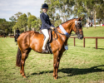

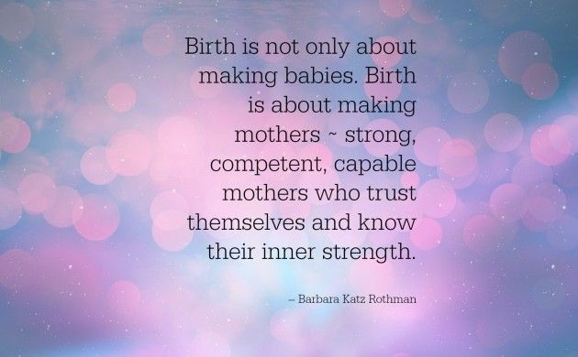
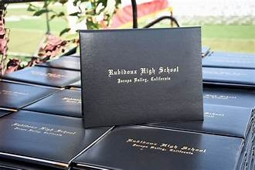

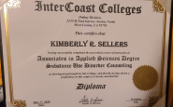


My Life Journey
September 1973
1976
Started showing horses
1978-1982
Started Junior High school
July 23 1968
Went to school
September 1982
Started High School
1986
GRADUATION
2nd Child
August 12 1994
Ryan Matthew was born
First Child
October 04 1988
Jeremy Richard was born
AUGUST,2024
Present
May 2020
Received my AAS Degree
Started College at
Intercoast College
2017

