Slide 1


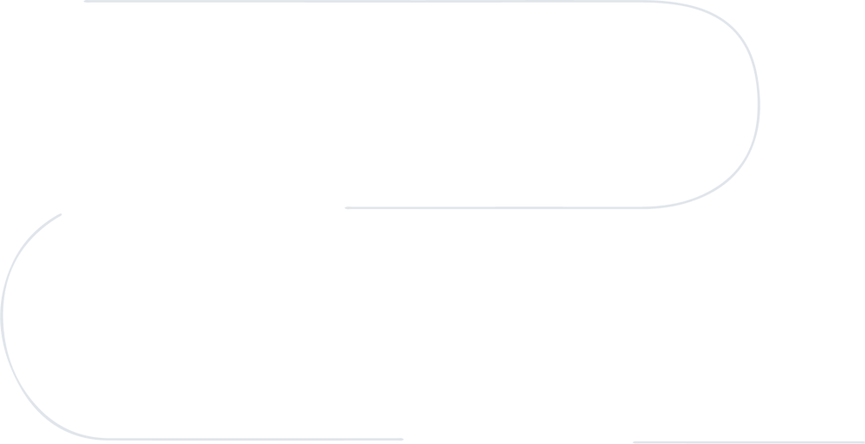









Career Path
Awards Won During
Entrepreneurial Journey
Software Engineering
(NUST)
Went to National Incubation Center to work on my Startups
Spark Expo - Best Monetizing Idea
Preston Entrepreneurial Challenge - First Runner Up
Pakistan Startup Cup – Regional Winner
High Achiever Award at NUST
Product Owner at Rocville Technologies
Associate Product at Quixel - Epic Games
I worked there as a task master. Following strict agile methodolgies. Prioritizing, assigning and gathering tasks for the team to deliver the project promptly.
Worked on Freight Forwarding and Logistic Management system (Requirements gathering till development)
EMBA - NUST
Operations Specialists
Promoted
Product Manager
at Rockville
Sr. Product Manager /Head of Marketing
Managed day to day tasks. Liason between cross functional teams. I was promoted to lead the marketing team of Asian region
Ropay (Web and App) - Fintech
Vidly Platform - OTT
Bajao Platform - OTT
Star Performer of the year
Wapda Website Revamped
Rockville Games
PAYPAL - Easypaisa - JazzCash
Telecom Sector - VAS services - Mobile Billings
online vouchers

